Slide 1
NLP 3
Transformers, LLM, embeddings

Slide 2
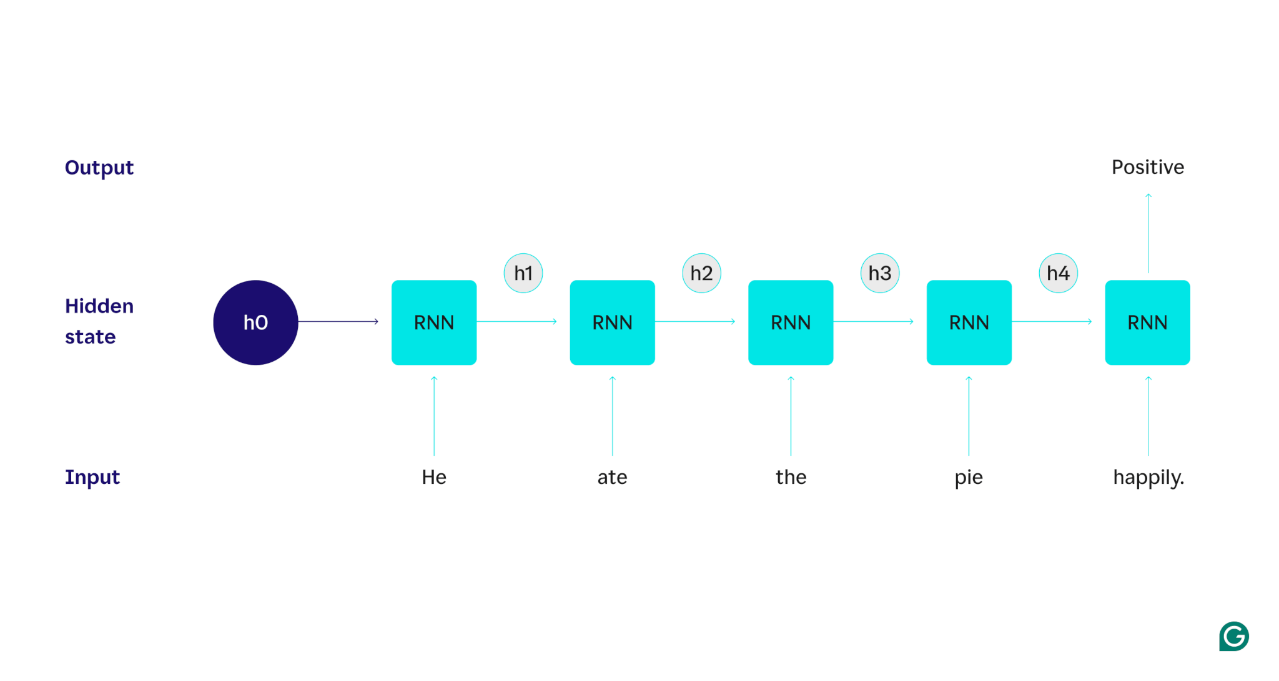
RNN

Slide 3
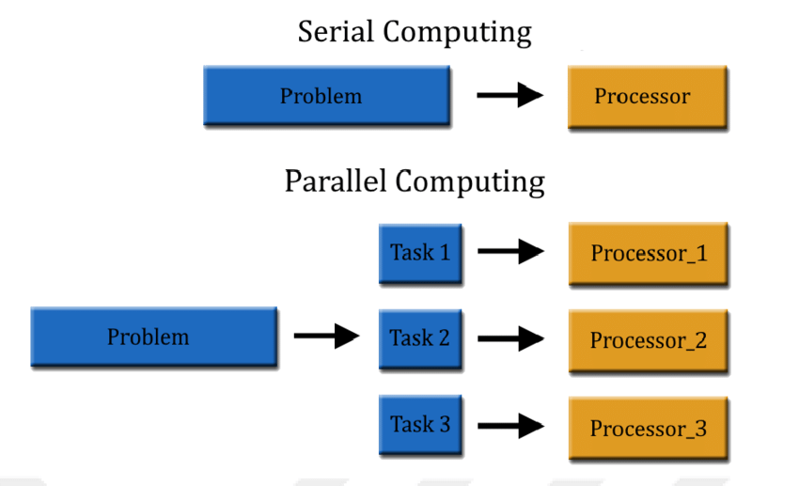
RNN issues
Processing is slow
RNN struggle with long-range dependencies (even with LSTMs)

Slide 4
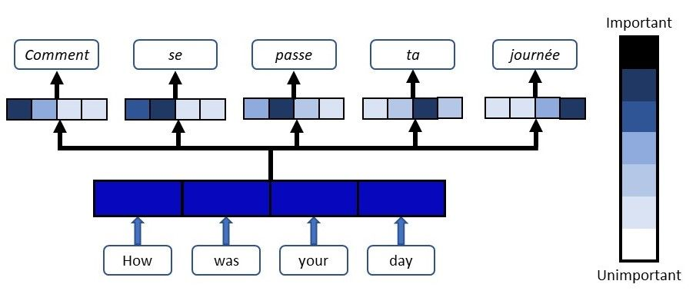
Attention

Slide 5
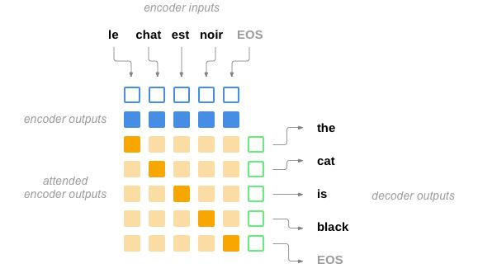
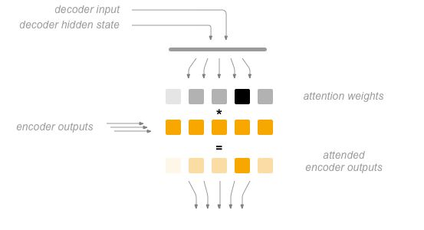
Attention

Slide 6
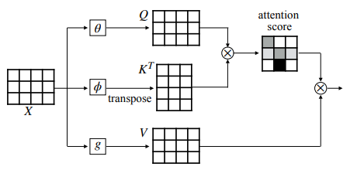
Transformers: Self-attention

Slide 7
Transformers: Self-attention
Input Word ("it")
Tokenizer -> ID (56)
Embedding Matrix -> Word Embedding (vector x)
Vector goes through a multiplication:
x -> Multiply by W_Q -> Query vector (q)
x -> Multiply by W_K -> Key vector (k)
x -> Multiply by W_V -> Value vector (v)

Slide 8
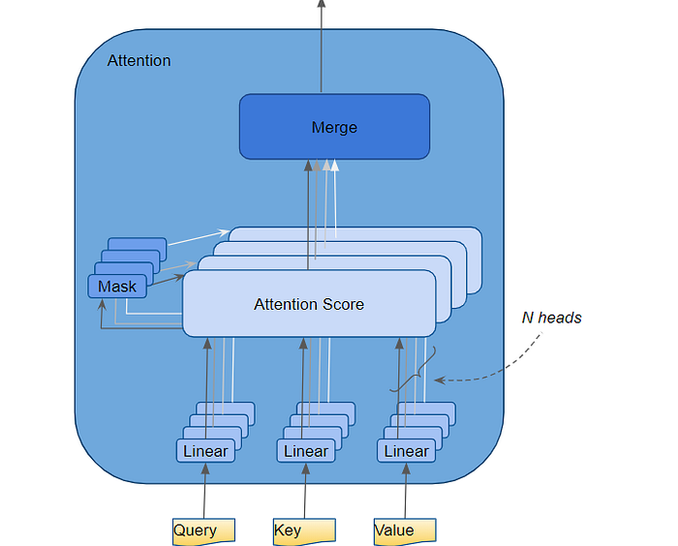
Multi-head attention

Slide 9
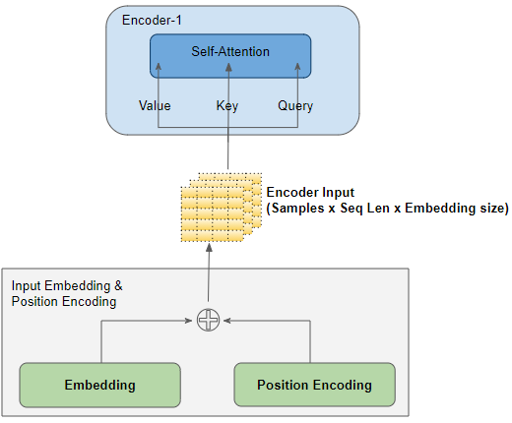
Positional Encodings

Slide 10
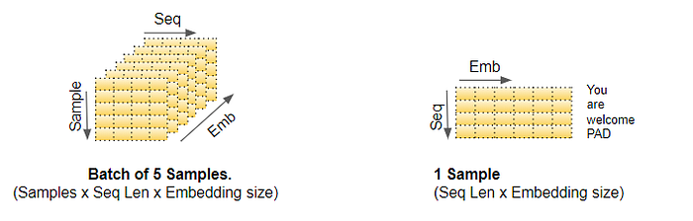
Encoder Input

Slide 11
Nice article
Medium

Slide 12
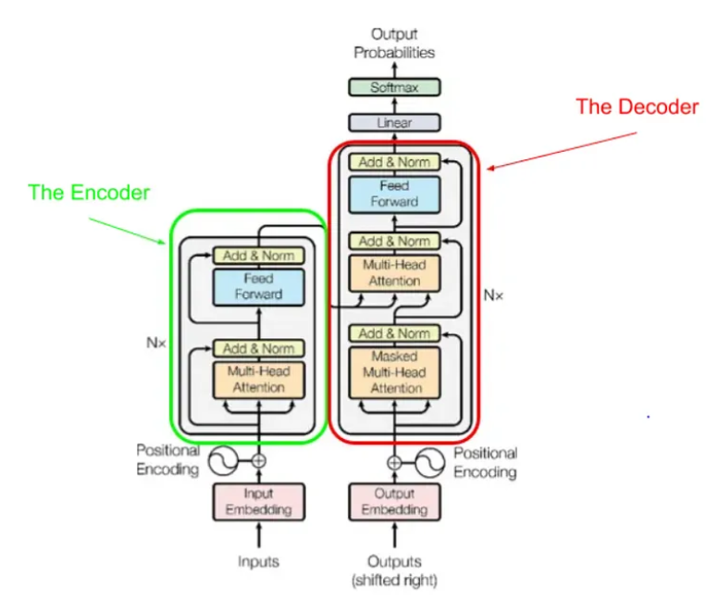
Encoder-decoder

Slide 13
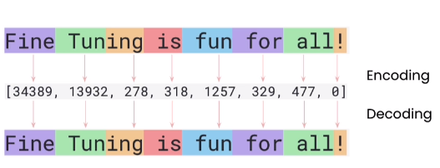
Tokenization

Slide 14
LLM
Encoder-only models
Decoder-only models
Encoder-Decorer models

Slide 15
Encoder-only Models (The Understanders)
Examples: BERT, RoBERTa, DistilBERT
Architecture: Uses only the Transformer's encoder stack.
How it Learns: Trained on a Masked Language Modeling (MLM) objective. It takes a sentence, randomly hides about 15% of the words ([MASK]), and its only job is to predict what those hidden words are. To do this, it must learn a deep, bi-directional understanding of the text.
Best for: Tasks that require a deep understanding of the full context of a sentence, such as text classification, sentiment analysis, and Named Entity Recognition (NER).

Slide 16
Decoder-only Models (The Generators)
Examples: The GPT series (from OpenAI), Llama (from Meta), Claude (from Anthropic), Gemini (from Google).
Architecture: Uses only the Transformer's decoder stack.
How it Learns: Trained on a simple Next-Token Prediction objective. Given a sequence of text, its only job is to predict the most probable next word.
Best for: Any generative task. This is the dominant architecture for chatbots, content creation, creative writing, and general-purpose conversational AI.

Slide 17
Encoder-Decoder Models (The Converters)
Examples: The original Transformer, T5, BART.
Architecture: Uses the full Transformer structure.
How it Learns: Trained specifically on tasks that require converting an input sequence into a new output sequence.
Best for: Sequence-to-sequence tasks like translation, summarization, and document rephrasing.

Slide 18
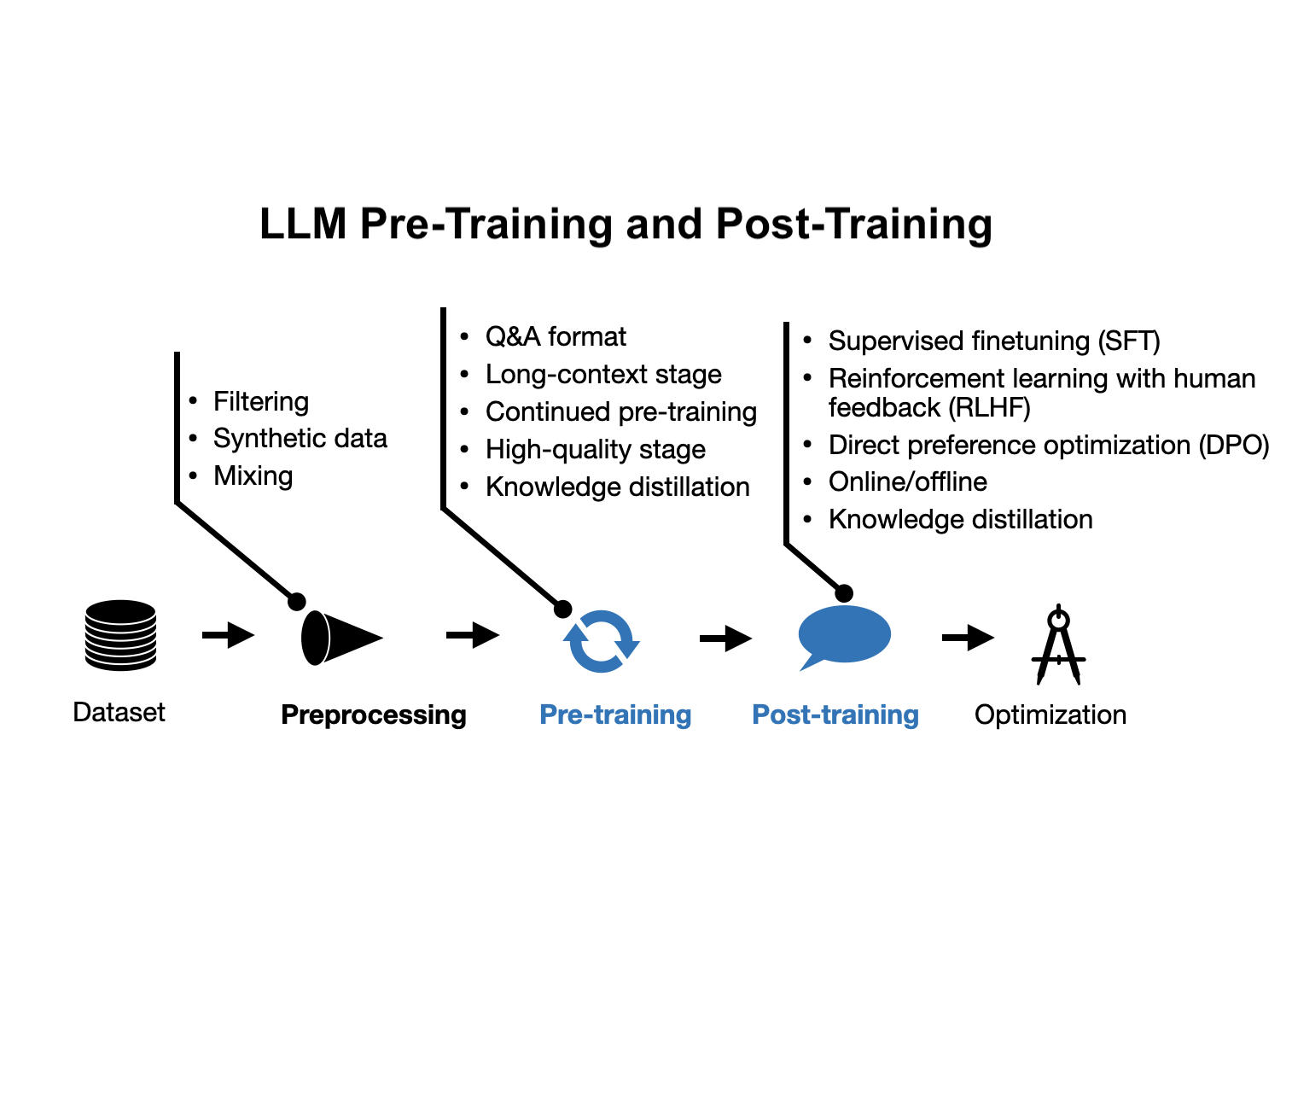
LLM training

Slide 19
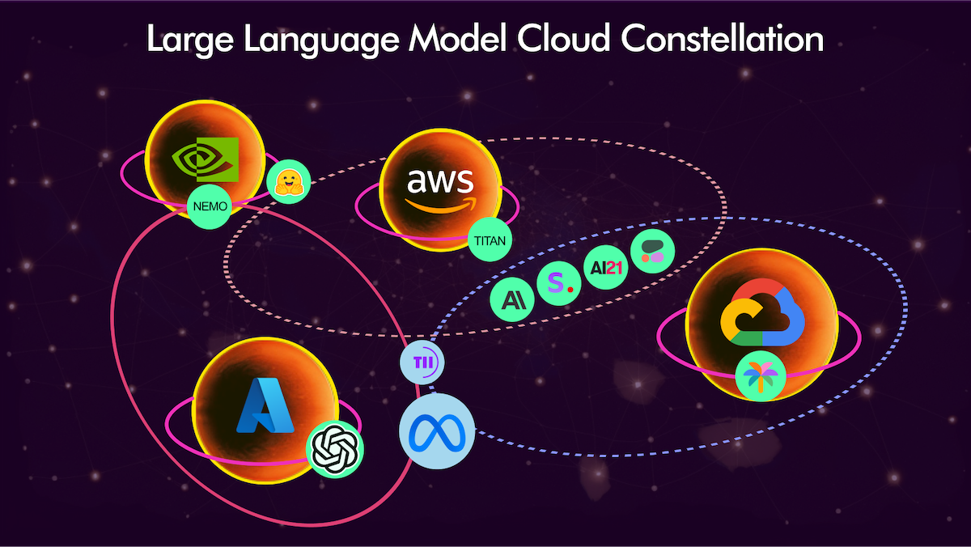
LLM serving - cloud
Key Players: OpenAI (with their GPT series), Google (the Gemini family), and Anthropic (the Claude family).
Pros:
Access to the most powerful models available.
Zero hardware setup or maintenance.
Highly scalable.
Cons:
Pay-per-use, which can become costly.
Data privacy concerns, as you are sending your data to a third-party service.
Requires a constant internet connection.

Slide 20
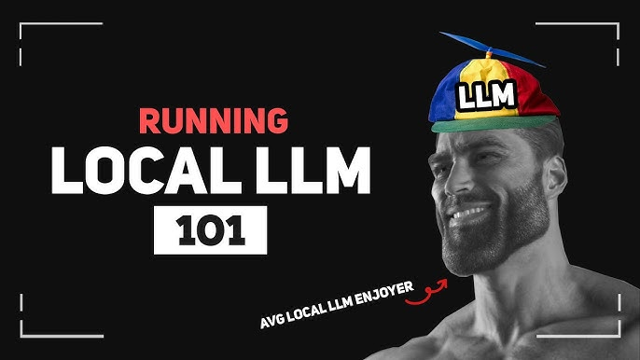
Llm serving - local
Key Enabler: A tool called Ollama has made this process remarkably simple. It acts as a package manager, allowing you to download and run leading open-source models like Meta's Llama 3 or models from Mistral with a single command.
Pros:
Complete data privacy and control.
No per-call cost after initial hardware investment.
Works offline.
Cons:
Requires capable hardware (especially significant amounts of RAM and a good GPU).
Models are powerful but often slightly behind the performance of the absolute top-tier commercial models.
You are responsible for setup and management.

Slide 21
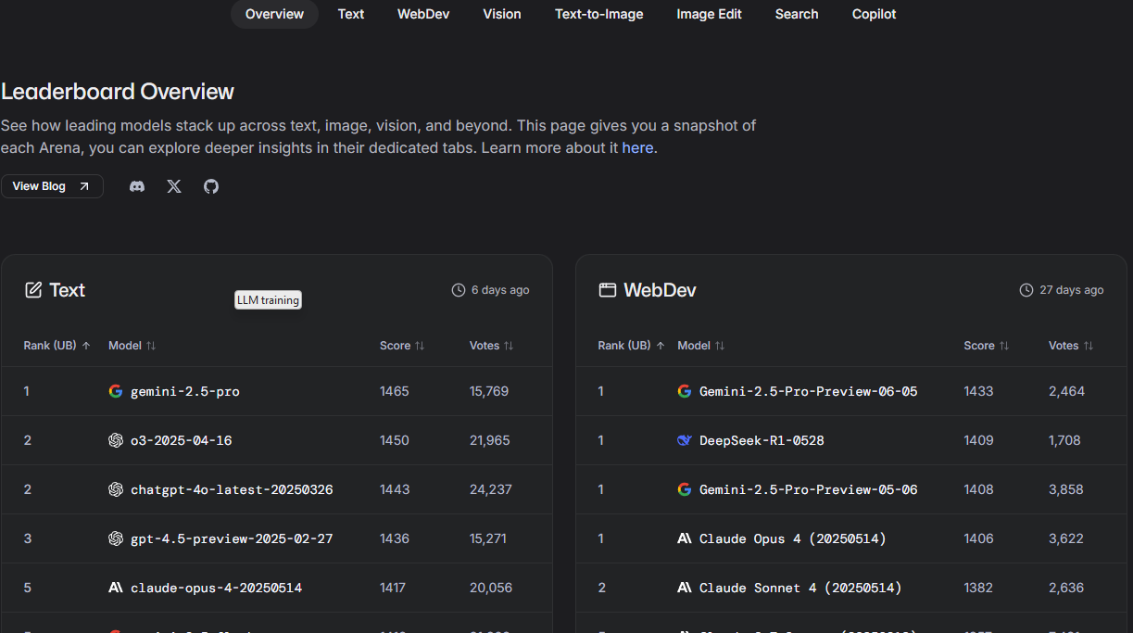
Lmsys

